Slide 1
Unit IV

Slide 2
Syllabus
Basic processing unit, ALU operations, Instruction execution, Branch instruction, Multiple bus organization, Hardwired control, Generation of control signals, Micro-programmed control; Pipelining: Basic concepts of pipelining, Performance, Hazards-Data, Instruction and Control, Influence on instruction sets.

Slide 3
Basic Processing unit
Processing unit – executes machine instructions and coordinates the other functions of other units.
This is often named as instruction processor/processor.
Its internal structure is evaluated here and how it fetches, decodes and executes instructions.
The processing unit was called as the central processing unit.
Since modern computers have many processors, it is not called as central.
The advancement in technology, makes processors act in parallel as much as possible.

Slide 4
Basic Processing unit
High performance processors have pipelined organization.
pipelined organization – execution of instruction starts before preceding instruction.
Superscalar operation – several instructions are fetched and executed at the same time;
A typical computing task – series of task specified by a sequence of instructions called program.

Slide 5
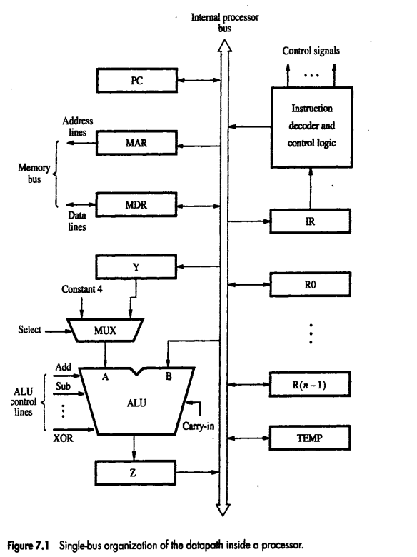

Slide 6
Basic Processing unit
ALU is interconnected to other registers through this internal bus.
Data and address lines of the external memory are connected through MDR an MAR respectively.
MDR – 2 inputs and 2 outputs.
Data is loaded into MDR either through memory bus/internal processor bus.
Input to MAR is connected to internal bus and output is connected to external bus.
Control lines of memory are connected to instruction decoder and control logic block.
Issues the control signal that control the operation of all the units inside the processor and for interacting with the processor.

Slide 7
The number and use of registers R0 to R(n-1) varies considerably from one processor to another.
Registers – general purpose by the programmer.
Some registers are dedicated as special purpose registers – index registers/stack registers.
Y,Z,TEMP – transparent to the programmer.
Used by processor for temporary storage during execution of instructions.
Never used for storing data that are later use by another instruction.

Slide 8
Multiplexer MUX, selects output of register Y/constant value 4 – which is input A to ALU.
4 – increments the content of PC
MUX control input SELECT
Select4 and SelectY

Slide 9
Multiplexer MUX, selects output of register Y/constant value 4 – which is input A to ALU.
4 – increments the content of PC
MUX control input SELECT
Select4 and SelectY
As instruction execution progresses, data are transferred from one register to another passing through ALU.
Instruction decoder and control unit – implements the actions specified by instruction in the IR register.
Decoder generates the signal needed to select the registers involved and directs the transfer of data.
Registers + ALU + interconnecting bus = datapath

Slide 10
With few exceptions, the sequence of operations are:
Transfer a word of data from one processor to another/ALU
Perform ALU operation and store result in processor register
Load contents from memory location to processor register.
Store a word of data from processor register into memory location.

Slide 11
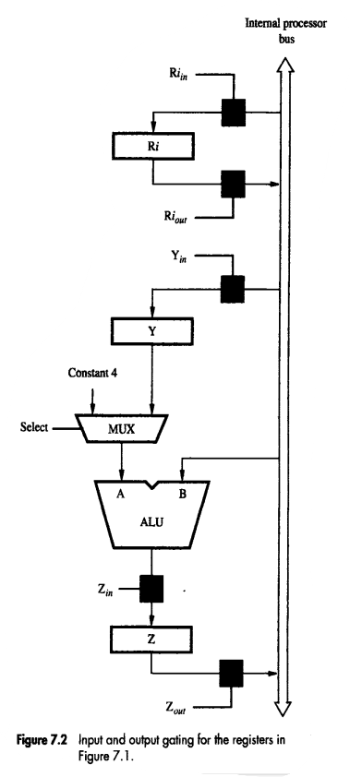
Register transfers
During instruction execution, a sequence of steps are executed in which data are transferred from one register to another.
Each register – 2 control signals.
Place the contents of register on the bus
Load data on the bus to register.
Input switch - Ri _{in}and
Output switch - Ri _{out}
when Ri _{in} is 1, data on bus are loaded into Ri _{in}
when Ri _{out} is 1, content of Register Ri are placed on bus.
While Ri _{out} =0, the bus can be used for transferring data from other registers.

Slide 12
Register transfers
Transferring data from R1 to R4
Enable o/p of R1, R1_{out} to 1 → places the contents of R1 on the processor bus.
Enable i/p of R4, R4_{in} to 1 → loads the data from the processor bus into R4.

Slide 13
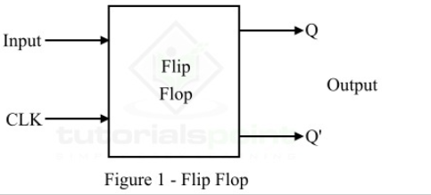
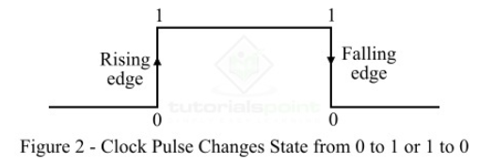
Flip flop
1 – bit memory cell that stores data.
Stores 0 or 1.
2 types:
Edge triggered
Level triggered.
Level triggered:
Activated when the clock signal is either 1 or 0.
Edge triggered:
Activated when clock changes its state. Either from 1 to 0 or from 0 to 1.

Slide 14
All operations and data transfers within processor takes place within time periods defined by the processor clock.
Control signals – govern a particular transfer at the start of the clock cycle.
Ex: R1_{out} and R4_{in} = 1
Registers consist of edge triggered flip-flop, hence at next active edge of the clock – R4_{in} will load input that is waiting.
Then, R1_{out} and R4_{in} = 0

Slide 15
When edge triggered flip-flops are not used, 2 or more clocks may be needed to guarantee the proper transfer of data – multiphase clocking

Slide 16
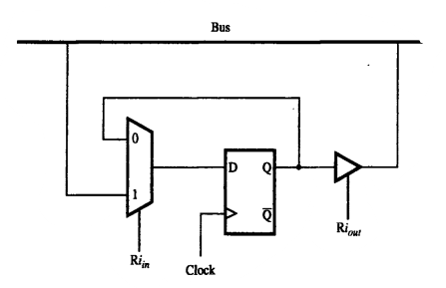
A single bit implementation
A 2 i/p multiplexer is shown,
Selects the data applied to the input of an edge triggered D flip-flop.
When Ri _{in}= 1, the multiplexer selects the data on the bus
This data is loaded into flip-flop at the rising edge of the clock.
When Ri _{in}= 0, the multiplexer feeds back the value currently stored in the flip-flop.

Slide 17
A single bit implementation
The Q output is connected to the bus via a tri-state gate.
When Ri _{out}= 0, it means the output is in high impedance state – this is the open circuit state of the switch.
When Ri _{out}= 1, the gate drives the bus to 0 or 1 – depending on value of Q.

Slide 18
Performing an arithmetic and logic unit operation
ALU – combinational circuit with no internal storage.
Performs arithmetic operations on A and B
One operand is from MUX and the other is got directly from bus.
The result from ALU is temporarily stored in register Z.
Sequence of operation to add contents of register R1 to R2 and store the result in R3 is,
R1 _{out}, Y_{in}
R2 _{out} , Select Y, Add, Z_{in}
Z _{out}, R3 _{in}

Slide 19
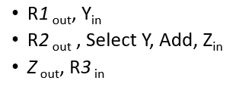
Signals whose name are given in the step is activated during the clock cycle.
Other signals – deactivated.
Step1: o/p of R1 and i/p of Y – enabled → contents of R1 are transferred to Y.
Step2: the MUX selects Y, which is A
→the contents of R2 are gated onto bus and is B.
→ALU performs the operation based on the signals applied to control line.
→ add line = 1, hence addition is performed.
→the output of ALU is the sum of A and B.
→the sum is loaded into Z – its i/p control signal is activated.
Step3: contents of Z are loaded into R3 – destination register.
→this cannot be done in step2 – only one o/p can be connected to the bus.

Slide 20
We assume that there are dedicated signals for each operations – addition, subtraction, division and multiplication.
But in reality ALU performs 8 diff operations but 3 signals are sufficient.

Slide 21
Fetching a word from memory
To fetch a word, the address is specified by the processor, then requests a read operation – applies whether an instruction / operand is to be fetched.
The processor transfers the required address to MAR.
The output is connected to the address lines of the memory bus.
The control lines of the memory bus is used to specify a read operation.
When the data is received, it is placed in MDR and then required transfer is made.

Slide 22
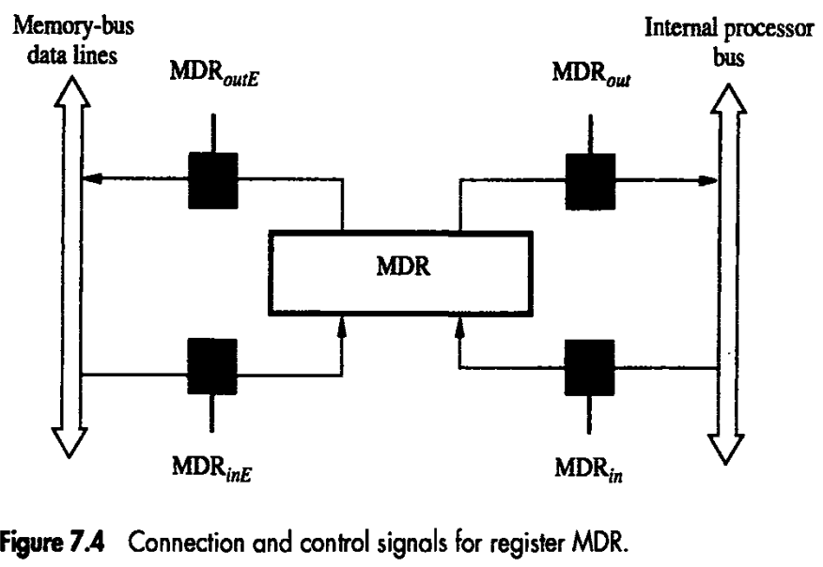

Slide 23
4 control signals.
MDR _{in} and MDR _{out} → Controls the connection to the internal bus.
MDR _{inE} and MDR _{outE} → controls the connection to the external bus.
A 3 i/p multiplexer can be used – memory data line connected to the third input – selected when MDR _{inE} =1
A second tri state gate controlled by MDR _{outE} can be used to connect the output of flip-flop to the memory bus.
During the R/W operations, the timing of the internal processor operations should be coordinated with the response of the addressed device on the memory bus.
Internal processor completes data transfer in 1 clock cycle.
Speed of addressed device varies with the device.
Some I/O operations and cache miss, introduces a delay in clock cycle.
To balance this, a signal called Memory Function Completed (MFC) is used.
Processor waits for MFC.
MFC = 1 → read operation is over and data is available in the memory bus.

Slide 24
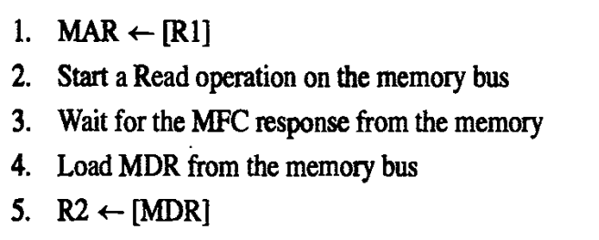
Ex: Mov (R1), R2

Slide 25
Actions can be carried out as separate steps – some can be combined into a single step.
Each action can be completed in 1 clock cycle.
Except action 3, which requires 1 or more clock cycles – this depends on the speed of the addressed device.
Simply, assume the o/p of MAR is enabled all the time.
Contents of the MAR are always available in memory bus – processor is the bus master here.
When a new address is loaded into the MAR – it will appear on the memory bus at the beginning of the next clock cycle.
A read signal is activated, at the same time MAR is loaded.
This signal will cause a bus interface circuit to send a read command, MR on the bus.
Step 1 & 2

Slide 26
Action 3 & 4, can be combined by activating control signal MDR _{inE} while waiting for a response from the memory.
Data received from memory are loaded into MDR at the end of the clock cycle → MFC is received.
MDR _{Out} is activated to transfer data to R2.
Step 3 & 4

Slide 27
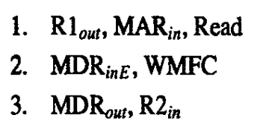
The read operation can be simplified as,
WMFC →makes the processor to wait for MFC signal.

Slide 28
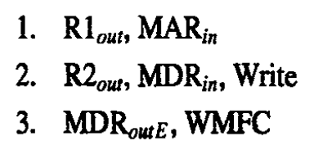
Storing a word in memory
The desired address is loaded into MAR.
Data to be written are loaded into MDR, then a write command is issued.
Move R2,(R1)
The processor remains in step3, until MFC is received.

Slide 29
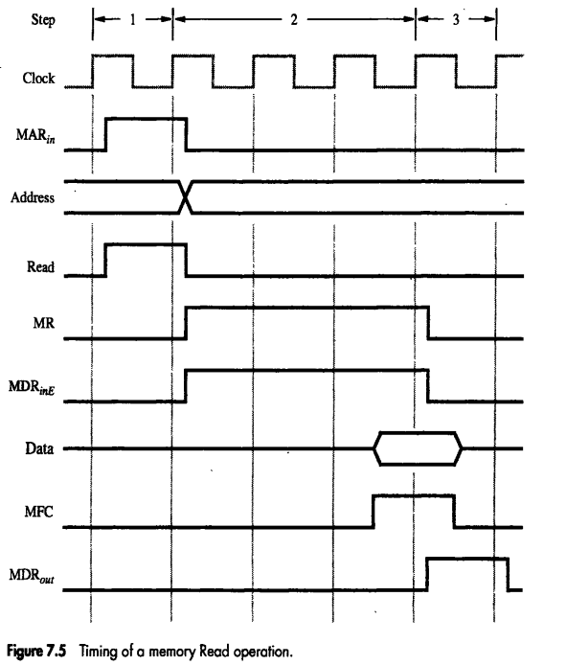

Slide 30
Execution of a Complete Instruction
Add (R3), R1
Fetch the instruction
Fetch the first operand (the contents of the memory location pointed to by R3)
Perform the addition
Load the result into R1

Slide 31
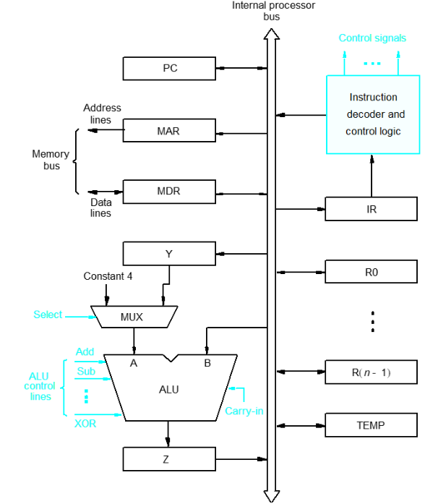
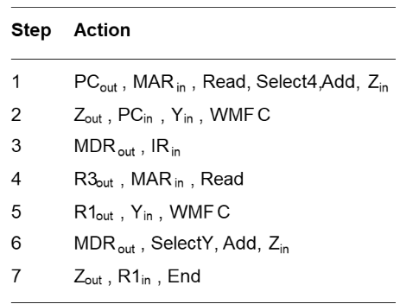
Execution of a Complete Instruction
Add (R3), R1
Figure. Control Sequence for Execution
Figure. Single Bus Organization of the Datapath inside a processor

Slide 32
Step 1-3 => Instruction Fetch Phase
Step 4 -7 => Execution Phase
Add (R3), R1
1000
1008
R3
.
.
.
10
R1
1008
PC
IR
Add (R3), R1

Slide 33
Execution of Branch Instruction
A branch instruction replaces the contents of PC with the branch target address, which is usually obtained by adding an offset X given in the branch instruction.
The offset X is usually the difference between the branch target address and the address immediately following the branch instruction.
UnConditional branch

Slide 34
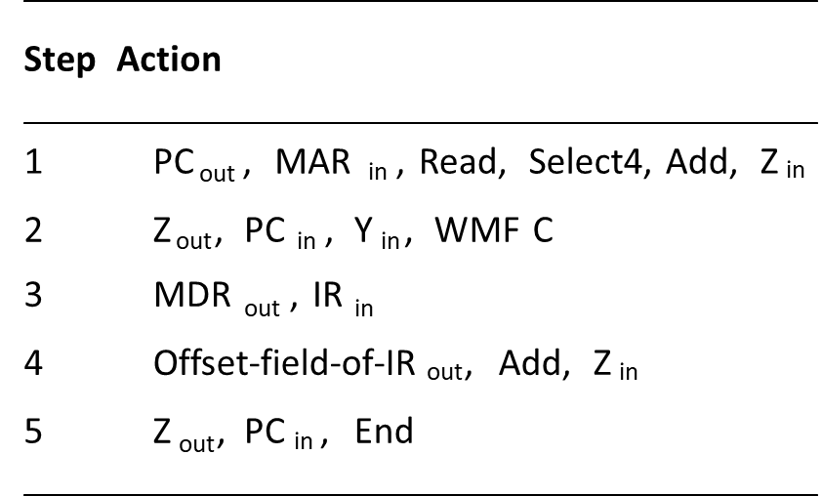
Execution of Branch Instruction
Figure. Control Sequence for Unconditional Branch Instructions

Slide 35
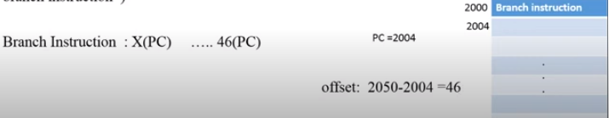
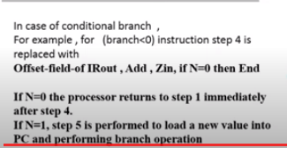

Slide 36
Bus
Simple single-bus structure
Has one common bus for data transfer.
Interconnected circuits/devices which has varying speed of execution like CPU and memory.
Results in long control sequences, because only one data item can be transferred over the bus in a clock cycle.
Multi-bus structure
Most commercial processors provide multiple internal paths to enable several transfers to take place in parallel.
Data transfer requires less control sequences.
Mutiple data transfer can be done in a single clock cycle

Slide 37
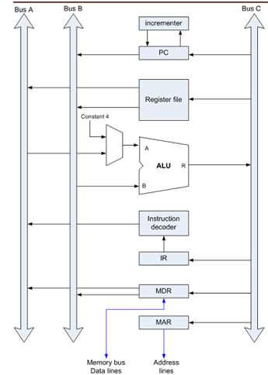
Multibus Architecture

Slide 38
Multibus Architecture
Three-bus organization to connect the registers and the ALU of a processor.
All general-purpose registers are combined into a single block called register file.
Register file has three ports.
Two outputs ports connected to buses A and B, allowing the contents of two different registers to be accessed simultaneously, and placed on buses A and B.
Third input port allows the data on bus C to be loaded into a third register during the same clock cycle.
Inputs to the ALU and outputs from the ALU:
Buses A and B are used to transfer the source operands to the A and B inputs of the ALU.
Result is transferred to the destination over bus C.

Slide 39
ALU can also pass one of its two input operands unmodified if needed:
Control signals for such an operation are R=A or R=B. (Passing the value of A to Bus C through ALU or Passing the value of B to Bus C through ALU)
Three bus arrangement obviates the need for Registers Y and Z in the single bus organization.
Incrementer unit: Used to increment the PC by 4.
Source for the constant 4 at the ALU multiplexer can be used to increment other addresses such as the memory addresses in multiple load/store instructions.

Slide 40
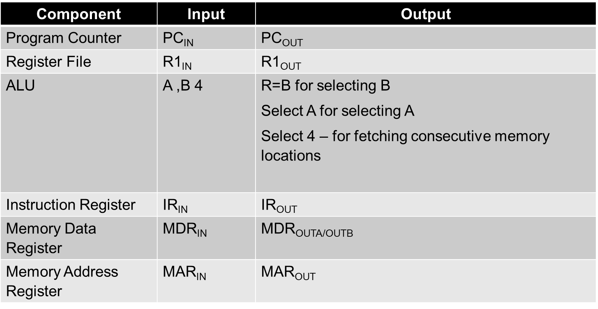
Input Output Specifications

Slide 41
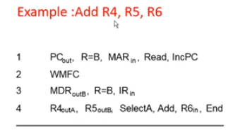
Execution of the Statement “Add R4 R5 R6” in multibus environment
PC value is passed to Bus B, From bus B (Through ALU) to Bus C.
Bus C to MAR
PC value will be incremented
Wait for Memory function complete operation
MDR(out) to Bus B (Instruction to B)
B to IR
R4 given to Bus A
R5 Given to Bus B
Select A => means A will be selected in ALU. Bus B passes R5 value directly.
The OP of ALU will be passed to Bus C and to Register R6

Slide 42
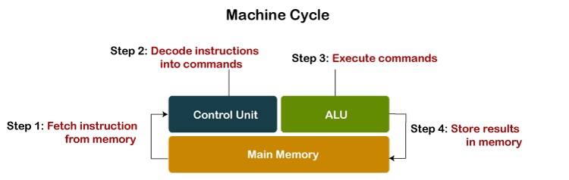
ALU is a main component of the central processing unit, which stands for arithmetic logic unit and performs arithmetic and logic operations. It is also known as an integer unit (IU) that is an integrated circuit within a CPU or GPU, which is the last component to perform calculations in the processor.
It has the ability to perform all processes related to arithmetic and logic operations such as addition, subtraction, and shifting operations, including Boolean comparisons (XOR, OR, AND, and NOT operations). Also, binary numbers can accomplish mathematical and bitwise operations.
The arithmetic logic unit is split into AU (arithmetic unit) and LU (logic unit). The operands and code used by the ALU tell it which operations have to perform according to input data. When the ALU completes the processing of input, the information is sent to the computer's memory.

Slide 43
Except performing calculations related to addition and subtraction, ALUs handle the multiplication of two integers as they are designed to execute integer calculations; hence, its result is also an integer.
However, division operations commonly may not be performed by ALU as division operations may produce a result in a floating-point number.
Instead, the floating-point unit (FPU) usually handles the division operations; other non-integer calculations can also be performed by FPU.

Slide 44
What is Pipelining?
A way of speeding up execution of instructions
Key idea:
overlap execution of multiple instructions

Slide 45
The Laundry Analogy
●
A, B, C, D
each have one load of clothes to wash, dry, and fold
A B C D
●
Washer takes 30 minutes
●
Dryer takes 30 minutes
●
“Folder” takes 30 minutes
●
“Stasher” takes 30 minutes to put clothes into drawers

Slide 46
If we do laundry sequentially...
6 PM 12
7 8 10 11 1
2 AM
9
●
●
30 30 30 30 30 30 30 30 30 30 30 30 30 30 30 30
Time
T
a s k
O
r C
d e r
A
B
D

Slide 47
To Pipeline, We Overlap Tasks
6 PM 12 2 AM
7 8 10 11 1
9
30
30 30 30 30 30 30
Time
Pipelining doesn’t help latency of single task, it helps throughput of entire workload
Pipeline rate limited by slowest
pipeline stage
Multiple tasks operating simultaneously
Potential speedup = Number pipe stages
Unbalanced lengths of pipe stages reduces speedup
Time to “fill” pipeline and time to “drain” it reduces speedup
T
a s k
O
r d
e D
r
A
B
C
Latency is the time from start to finish for a given task.
Throughput is the number of tasks completed in a given time period.
12

Slide 48

Pipelining is a process of arrangement of hardware elements of the CPU such that its overall performance is increased.
Simultaneous execution of more than one instruction takes place in a pipelined processor.
Let us see a real-life example that works on the concept of pipelined operation. Consider a water bottle packaging plant. Let there be 3 stages that a bottle should pass through, Inserting the bottle(I), Filling water in the bottle(F), and Sealing the bottle(S). Let us consider these stages as stage 1, stage 2, and stage 3 respectively. Let each stage take 1 minute to complete its operation.
Now, in a non-pipelined operation, a bottle is first inserted in the plant, after 1 minute it is moved to stage 2 where water is filled. Now, in stage 1 nothing is happening. Similarly, when the bottle moves to stage 3, both stage 1 and stage 2 are idle. But in pipelined operation, when the bottle is in stage 2, another bottle can be loaded at stage 1. Similarly, when the bottle is in stage 3, there can be one bottle each in stage 1 and stage 2. So, after each minute, we get a new bottle at the end of stage 3. Hence, the average time taken to manufacture 1 bottle is:

Slide 49
The same principles apply to processors where we pipeline instruction-execution.
MIPS instructions classically take f ve steps:
1. Fetch instruction from memory.
2. Read registers while decoding the instruction. T e regular format of MIPS
instructions allows reading and decoding to occur simultaneously.
3. Execute the operation or calculate an address.
4. Access an operand in data memory.
5. Write the result into a register

Slide 50
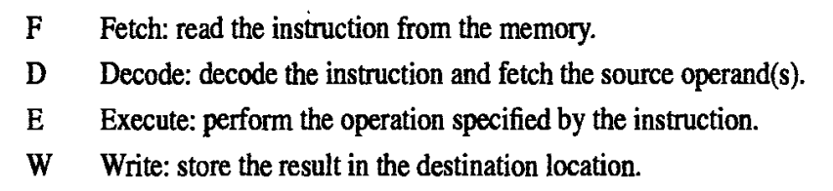

Slide 51
Pipelining a Digital System
●
Key idea: break big computation up into pieces
1ns
Separate each piece with a pipeline register
●
200ps
200ps
200ps
200ps
200ps
Pipeline Register

Slide 52
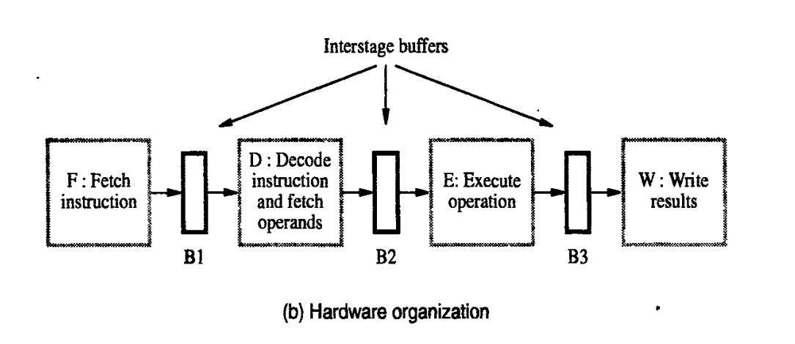

Slide 53
Pipelining a Digital System
Why do this? Because it's faster for repeated computations
Non-pipelined: 1operationfinishes every1ns
1ns
Pipelined: 1operationfinishes every200ps
200ps
200ps
200ps
200ps
200ps

Slide 54
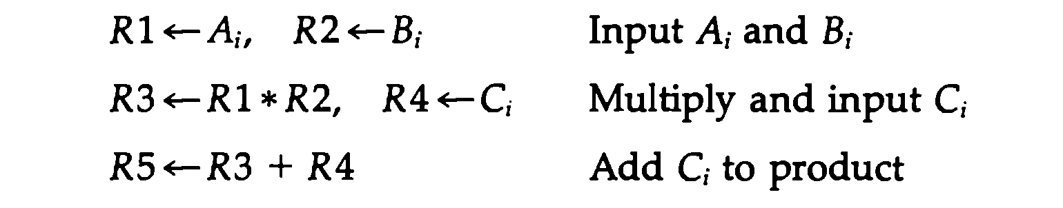
Suppose we need to perform multiply and add operation with a stream of numbers
●
●
●
Each subinstruction is implemented in a segment within the pipeline. Each segment has one or two registers and a combinational circuit
The sub operations performed in each segement are as follows
●
●
●

Slide 55
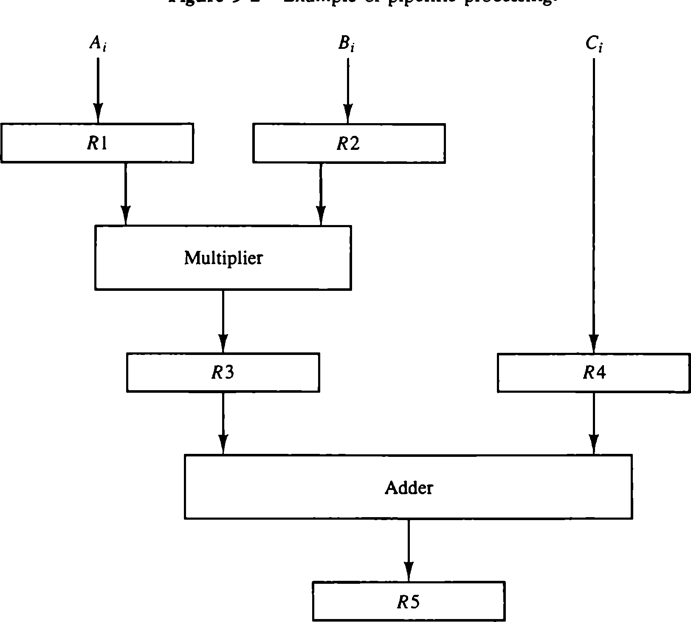
Example of Pipeline Processing

Slide 56
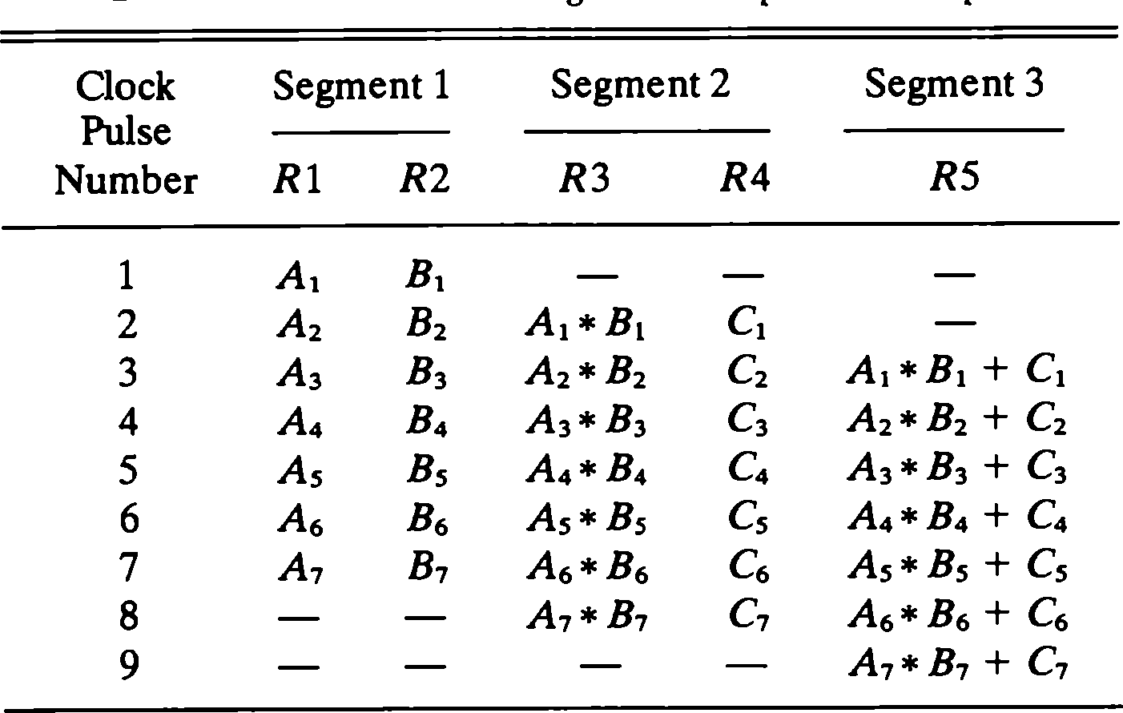
Content of Registers in Pipeline

Slide 57
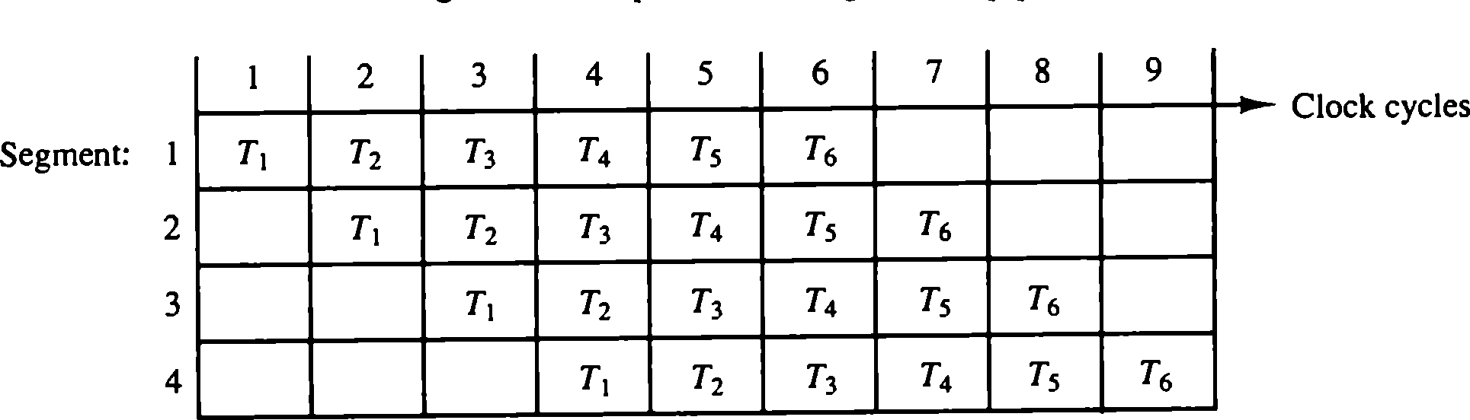
Space Time Diagram of Pipeline

Slide 58
Pipeline Hazards
There are situations in pipelining when the next instruction cannot execute in the
following clock cycle. T ese events are called hazards, and there are three different
types.
Where one instruction cannot immediately follow another
Types of hazards
Structural hazards - attempt to use the same resource by two or more instructions
Control hazards - attempt to make branching decisions before branch condition is evaluated
Data hazards - attempt to use data before it is ready
Can always resolve hazards by waiting

Slide 59
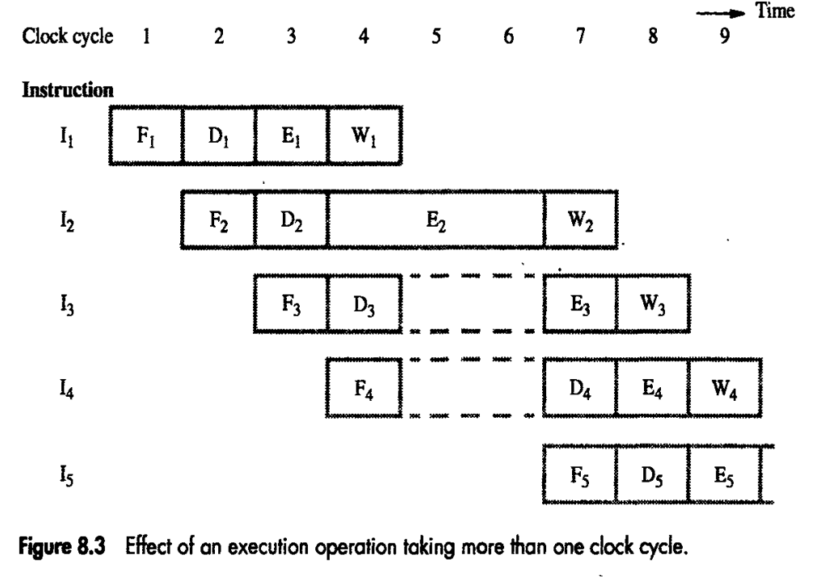

Slide 60
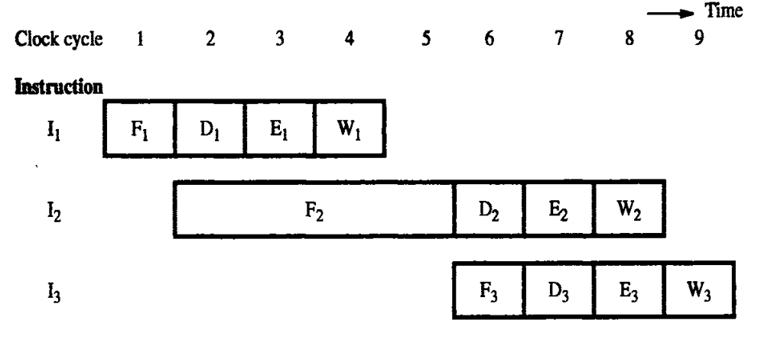
Instruction hazard

Slide 61
Structural hazard
Occurs when hardware is required by 2 instructions

Slide 62
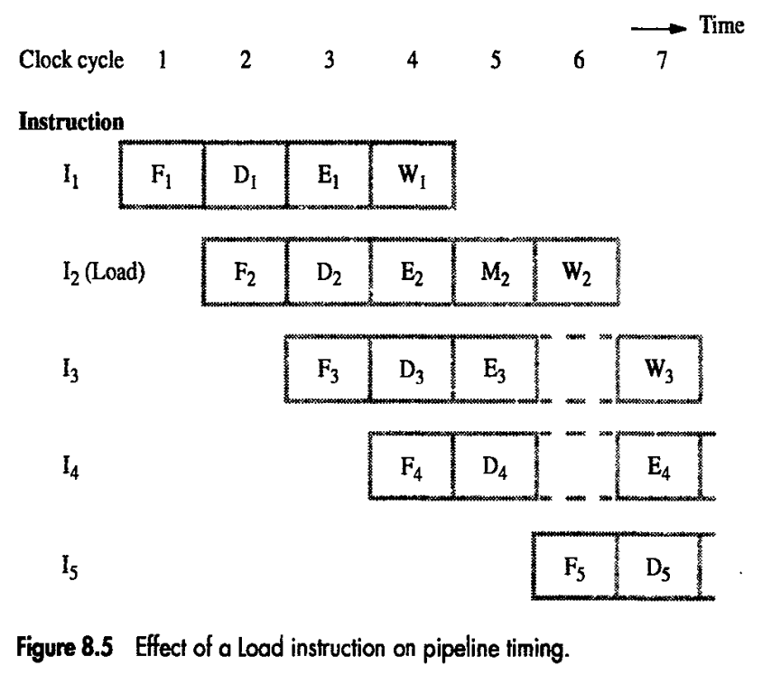

Slide 63
Data hazard
Data that is required is delayed for some reason.

Slide 64
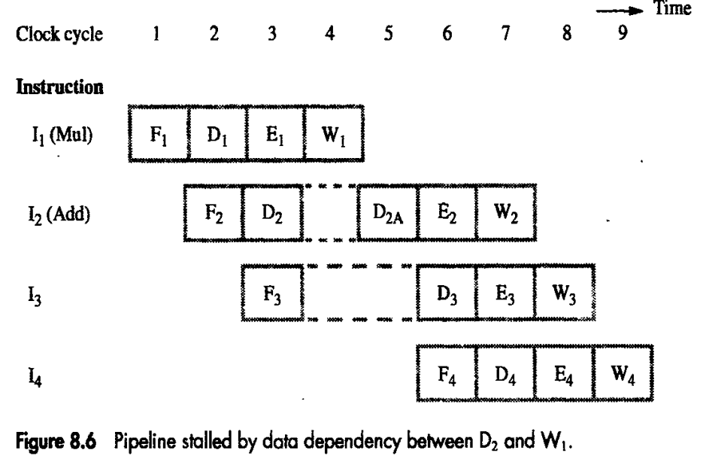

Slide 65
Structural Hazards
Attempt to use the same resource by two or more instructions at the same time
Example: Single Memory for instructions and data
Accessed by IF stage
Accessed at same time by MEM stage
Solutions
Delay the second access by one clock cycle, OR
Provide separate memories for instructions & data
» This is what the book does
» This is called a “Harvard Architecture”
» Real pipelined processors have separate caches

Slide 66
Example - Executing Multiple Instructions
Consider the following instruction sequence:
lw $r0, 10($r1) sw $sr3, 20($r4)
add $r5, $r6, $r7 sub $r8, $r9, $r10

Slide 67

Executing Multiple Instructions Clock Cycle 1
LW
IF/ ID
ID/ EX
EX/ MEM
MEM/ W B
ADD
ADD
4
<<2
PC
ADDR
RD
32
5
RN1
RN2
WN WD
RD1
Zero
Instruction
A LU
Me mory
5
R e giste r
5
File
RD2
M U X
ADDR
Data
Me mory^{RD}
WD
E X T N D
M
16
32
U
X
5

Slide 68
Executing Multiple Instructions Clock Cycle 2
SW
LW
IF/ ID
ID/ EX
EX/ MEM
MEM/ W B
ADD
ADD
4
<<2
PC
ADDR
RD
32
5
RN1
RD1
Zero
Instruction Me mory
RN2
WN
A LU
5
R e giste r
5
File
RD2
ADDR
Data
Me mory^{RD}
WD
WD
M U X
E X T N D
M U
16
32
X
5

Slide 69
Executing Multiple Instructions Clock Cycle 3
ADD
SW
LW
IF/ ID
ID/ EX
EX/ MEM
MEM/ W B
ADD
ADD
4
<<2
PC
ADDR
RD
32
5
RN1
RD1
Zero
Instruction Me mory
RN2
WN
A LU
5
R e giste r
5
File
RD2
ADDR
Data
Me mory^{RD}
WD
WD
M U X
E X T N D
M U
16
32
X
5

Slide 70
Executing Multiple Instructions Clock Cycle 4
SUB
ADD
SW
LW
IF/ ID
ID/ EX
EX/ MEM
MEM/ W B
ADD
ADD
4
<<2
PC
ADDR
RD
32
5
RN1
RD1
Zero
Instruction Me mory
RN2
A LU
5
R e giste r
5
WN
File
RD2
WD
M U X
ADDR
Data
Me mory^{RD}
WD
E X T N D
M
16
32
U
X
5

Slide 71
Executing Multiple Instructions Clock Cycle 5
SUB
ADD SW
EX/ MEM
LW
IF/ ID
ID/ EX
MEM/ W B
ADD
ADD
4
PC
<<2
ADDR
RD
32
5
RN1
RN2
RD1
Zero
Instruction Me mory
A LU
5
R e giste r
5
WN
File
RD2
WD
M U X
ADDR
Data
E X T N D
Me mory^{RD}
M U
16
32
WD
X
5

Slide 72
Executing Multiple Instructions Clock Cycle 6
SUB ADD
EX/ MEM
SW
IF/ ID
ID/ EX
MEM/ W B
ADD
ADD
4
PC
<<2
ADDR
RD
32
5
RN1
RN2
WN WD
RD1
Zero
Instruction Me mory
A LU
5
R e giste r
5
File
RD2
ADDR
Data
Me mory^{RD}
WD
M U X
E X T N D
M U
16
32
X
5

Slide 73
Executing Multiple Instructions Clock Cycle 7
SUB
ADD
IF/ ID
ID/ EX
EX/ MEM
MEM/ W B
ADD
ADD
4
PC
<<2
ADDR
RD
32
5
RN1
RN2
RD1
Zero
Instruction Me mory
A LU
5
R e giste r
5
WN
File
RD2
ADDR
Data
Me mory^{RD}
WD
WD
M U X
E X T N D
M U
16
32
X
5

Slide 74
Executing Multiple Instructions Clock Cycle 8
SUB
IF/ ID
ID/ EX
EX/ MEM
MEM/ W B
ADD
ADD
4
PC
<<2
ADDR
RD
32
5
RN1
RN2
RD1
Zero
Instruction Me mory
A LU
5
R e giste r
5
WN
File
RD2
WD
M U X
ADDR
Data
Me mory^{RD}
WD
E X T N D
M U
16
32
X
5

Slide 75
Alternative View - Multicycle Diagram
C C 1
C C 2
C C 3
C C 4
C C 5
C C 6
C C 7
C C 8
lw $ r0 , 10 ($ r1 )
IM
REG
ALU
DM
RE
G
sw $ r3 , 20 ($ r4 )
IM
REG
ALU
D
M
REG
add $ r5 , $ r6 , $ r7
IM
REG
ALU
DM
REG
sub $ r8 , $ r9 , $ r10
IM
REG
ALU
DM
RE
G

Slide 76
Alternative View - Multicycle Diagram
C C 1
C C 2
C C 3
C C 4
C C 5
C C 6
C C 7
C C 8
lw $ r0 , 10 ($ r1 )
IM
REG
ALU
DM
RE
G
Memory Conflict
sw $ r3 , 20 ($ r4 )
IM
REG
ALU
DM
REG
add $ r5 , $ r6 , $ r7
IM
REG
ALU
DM
REG
sub $ r8 , $ r9 , $ r10
IM
REG
ALU
DM
RE
G

Slide 77
Structural Hazards
Some common Structural Hazards:
Memory:
Floating point:
Since many floating point instructions require many cycles, it’s easy for them to interfere with each other.
Starting up more of one type of instruction than there are resources.
For instance, the PA-8600 can support two ALU + two load/store instructions per cycle - that’s how much hardware it has available.
•
•

Slide 78
Structural Hazards
Dealing with Structural Hazards
Stall :Stalling: the dependent instruction is “pushed back” for one or more clock cycles.
•
•
•
low cost, simple Increases CPI
use for rare case since stalling has performance effect
Pipeline hardware resource
•
•
•
useful for multi-cycle resources good performance
sometimes complex e.g., RAM
Replicate resource
•
•
•
good performance
increases cost (+ maybe interconnect delay) useful for cheap or divisible resources

Slide 79
Speed Up <= Pipeline Depth; if ideal CPI is 1, then:
Pipeline Depth
Clock Cycle Unpipelined
Speedup =
X
1 + Pipeline stall CPI
Clock Cycle Pipelined
Hazards limit performance on computers:
Structural: need more HW resources
Data (RAW,WAR,WAW)
Control

Slide 80



Data Hazards
Data hazards occur when data is used before it is ready
Time (in clock cycles)
Value of | CC 1 | CC 2 | CC 3 | CC 4 | CC 5 | CC 6 | CC 7 | CC 8 | CC 9
register $2: | 10 | 10 | 10 | 10 | 10/– 20 | – 20 | – 20 | – 20 | – 20
Program execution order
(in instructions)
sub $2, $1, $3 IM
Reg
DM
Reg
and $12, $2, $5
IM
Reg
DM
Reg
or $13, $6, $2
IM
Reg
DM
Reg
add $14, $2, $2
IM
Reg
DM
Reg
sw $15, 100($2)
IM
Reg
DM
Reg
The use of the result of the SUB instruction in the next three instructions causes a data hazard, since the register $2 is not written until after those instructions read it.

Slide 81
Data Hazards
Execution Order is:
Instr_{I}
Instr_{J}
Read After Write (RAW)
Instr_{J} tries to read operand before Instr_{I} writes it
I: | add | r1,r2,r3
J: | sub | r4,r1,r3
•
Caused by a “Dependence” (in compiler nomenclature). This hazard results from an actual need for communication.

Slide 82
Data Hazards
Execution Order is:
Instr_{I}
Instr_{J}
Write After Read (WAR)
Instr_{J} tries to write operand before Instr_{I} reads i
– Gets wrong operand
I: | sub | r4,r1,r3
J: | add | r1,r2,r3
K: | mul | r6,r1,r7
–
Called an “anti-dependence” by compiler writers. This results from reuse of the name “r1”.
Can’t happen in MIPS 5 stage pipeline because:
–
–
–
All instructions take 5 stages, and Reads are always in stage 2, and Writes are always in stage 5

Slide 83
Data Hazards
Execution Order is:
Instr_{I}
Instr_{J}
Write After Write (WAW)
Instr_{J} tries to write operand before Instr_{I} writes it
– Leaves wrong result ( Instr_{I} not Instr_{J} )
I: | sub | r1,r4,r3
J: | add | r1,r2,r3
K: | mul | r6,r1,r7
•
Called an “output dependence” by compiler writers This also results from the reuse of name “r1”.
•
Can’t happen in MIPS 5 stage pipeline because:
All instructions take 5 stages, and
Writes are always in stage 5
•
Will see WAR and WAW later in more complicated pipes

Slide 84
Data Hazard Detection in MIPS (1)
Read after Write
Time (in clock cycles)
Value of | CC 1 | CC 2 | CC 3 | CC 4 | CC 5 | CC 6 | CC 7 | CC 8 | CC 9
register $2: | 10 | 10 | 10 | 10 | 10/– 20 | – 20 | – 20 | – 20 | – 20
Program execution order
(in instructions)
IF/ID
ID/EX
EX/MEM MEM/WB
sub $2, $1, $3 IM
Reg
DM
Reg
and $12, $2, $5
IM
Reg
DM
Reg
or $13, $6, $2
IM
Reg
DM
Reg
add $14, $2, $2
IM
Reg
DM
Reg
sw $15, 100($2)
IM
Reg
DM
Reg
1a: EX/MEM.RegisterRd = ID/EX.RegisterRs 1b: EX/MEM.RegisterRd = ID/EX.RegisterRt
2a: MEM/WB.RegisterRd = ID/EX.RegisterRs 2b: MEM/WB.RegisterRd = ID/EX.RegisterRt
EX hazard
MEM hazard

Slide 85
Data Hazards
Solutions for Data Hazards
Stalling
Forwarding:
» connect new value directly to next stage
Reordering

Slide 86





Data Hazard - Stalling
0
2
4
6
8
10
12
16
18
add$s0,$t0,$t1
IF
ID EX MEM
W
s0
$s0
written here
STALL
BUBBLEBUBBLEBUBBLEBUBBLEBUBBLE
STALL
BUBBLEBUBBLEBUBBLEBUBBLEBUBBLE
sub$t2$,s0,$t3
IF
R
s0
EX MEM WB
$s0read here

Slide 87
Data Hazards - Forwarding
Key idea: connect new value directly to next stage
Still read s0, but ignore in favor of new result
0
2
4
6
8
10
12
16
18
ID
MEM
W
s0
add $ s0,$ t0,$ t1
IF
ID
EX
•
new value
of s0
IF
R
s0
EX
MEM
W
B
sub $ t2,$ s0,$ t3
Problem: what about load instructions?

Slide 88


Data Hazards - Forwarding
STALL still required for load - data avail. after MEM
MIPS architecture calls this delayed load, initial implementations required compiler to deal with this
0
2
4
6
8
10
12
16
18
ID
W
lw$s0,20($t1)
IF ID EX MEM
s0
newvalue of s0
STALL
BUBBLEBUBBLEBUBBLEBUBBLEBUBBLE
IF
R
s0
EX MEM WB
sub$t$2s,0,$t3

Slide 89
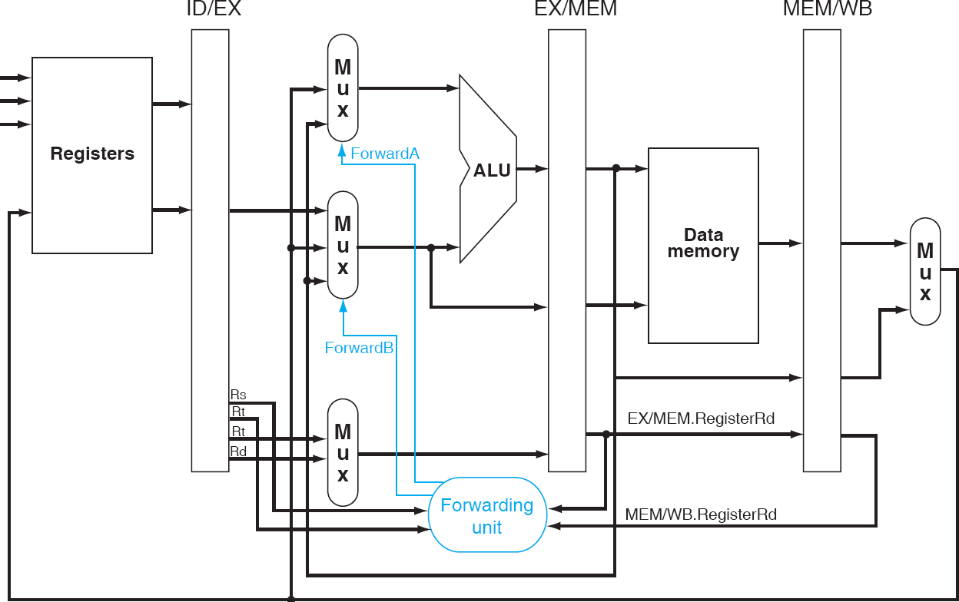
Forwarding
00 01
10
00
01
10
Add hardware to feed back ALU and MEM results to both ALU inputs

Slide 90
Data Hazards: A Classic Example
Identify the data dependencies in the following code. Which of them can be resolved through forwarding?
SUB | $2, | $1, | $3
OR | $12, | $2, | $5
SW $13, 100($2) ADD $14, $2, $2 LW
ADD
$15, 100($2)
$4, $7, $15

Slide 91
Data Hazards - Reordering Instructions
Assuming we have data forwarding, what are the hazards in this code?
lw $t0, 0($t1)
lw $t2, 4($t1) sw $t2, 0($t1) sw $t0, 4($t1)
Reorder instructions to remove hazard:
lw $t0, 0($t1) lw $t2, 4($t1) sw $t0, 4($t1) sw $t2, 0($t1)

Slide 92
Control Hazards
A control hazard is when we need to find the destination of a branch, and can’t fetch any new instructions until we know that destination.
A branch is either
–
–
Taken: PC <= PC + 4 + Immediate Not Taken: PC <= PC + 4

Slide 93
Control Hazards
Control Hazard on Branches Three Stage Stall
10: beq r1,r3,36
Ifetch
Reg
ALU
DMem
Reg
14: and r2,r3,r5
Ifetch
Reg
ALU
DMem
Reg
18: or r6,r1,r7
Ifetch
Reg
ALU
DMem
Reg
22: add r8,r1,r9
Ifetch
Reg
ALU
DMem
Re
g
36: xor r10,r1,r11
Ifetch
R
eg
ALU
DMem
Re
g
The penalty when branch take is 3 cycles!

Slide 94



Branch Hazards
Just stalling for each branch is not practical
Common assumption: branch not taken
When assumption fails: flush three instructions
Program execution order
(in instructions)
Time (in clock cycles)
CC 1 CC 2
CC 3
CC 4
CC 5
CC 6
CC 7
CC 8
CC 9
40 beq $1, $3, 7
IM
Reg
DM
Reg
44 and $
12, $2, $5
IM
Reg
DM
Reg
48 or $1
3, $6, $2
IM
Reg
DM
Reg
52 add $
14, $2, $2
IM
Reg
DM
Reg
72 lw $4, 50($7)
IM
R
eg
DM
Reg

Slide 95
Control Signals
The control signals are generated by the control unit to carry out the execution of instructions.
Once the instructions are fetched from the memory and placed in the IR, it is sent to the decoder unit to carry out the operation mentioned in the instructions.
Once the instruction is decoded, the appropriate control signals will be generated by the control unit.
The control signals are generated using two techniques, such as Hardwired and Microprogrammed control unit.
Hardwired Control Unit: it uses set of logic gates and circuits to execute instructions.
Mircoprogrammed Control Unit: it uses microcode to execute instructions. Microcode is a set of instructions that can be modified or updated.

Slide 96
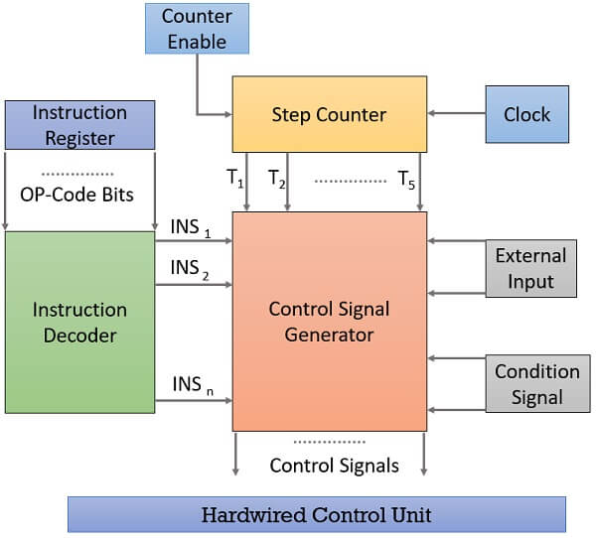
Hardwired Control Unit

Slide 97
Instruction Register: it is a processor register used to store the instructions that is currently being executed.
Instruction Decoder: it takes the Op code from the IR and it will send the OP code bits as the input to the Control Signal Generator.
Step Counter: it will mention the current step or state of the instruction such as fetch, decode, operands read, ALU and store. Based on the step the signals of the step counter will be set to 1 and given as the input to the Control Signal Generator.
Clock: one clock pulse is required to complete one state (step) of the instruction. Example if the step counter is in T3, after completing one clock signal the step counter will move to T4.
Counter Enable: it controls the step counter, even if one clock signal completed, the counter enable will allow the step counter to move to the next state (i.e. from fetch to decode).
Condition signal: start, stop or reset.
External input: it represents some kind of interrupt or any error message.

Slide 98
Microprogrammed Control Unit
The control signals required inside the processor can be generated using the control step counter and a decoder unit.
An alternative scheme, called microprogrammed control, in which control signals are generated by a program similar to a machine language program.
Common Terms:
Control Word: it is a word whose individual bits represents various control signals.
Microroutine: a sequence of CWs corresponding to the control sequence of a machine instruction constitutes a microroutine for that instruction.
Microinstruction: the individual control word in a microroutine are referred to as microinstruction.

Slide 99
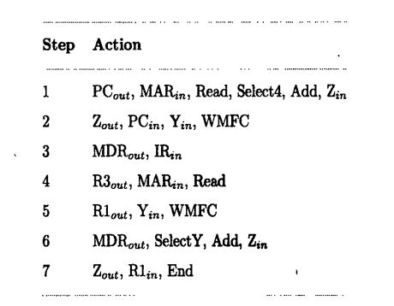
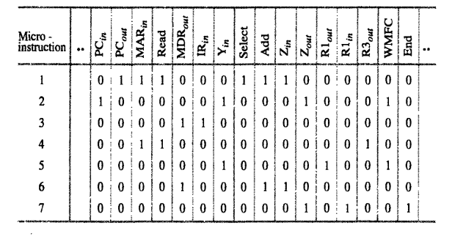
Control Sequence and Control Word for the instruction Add (R3),R1

Slide 100
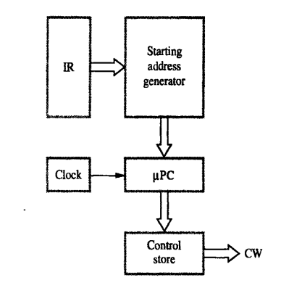
The microroutines for all the instructions in the instruction set of a computer are stored in a special memory called control store.
The control unit can generate the control signals for any instruction by reading the control word from the control store.
A micro program counter (µPC) is used to read the control words sequentially from the control store.

Slide 101
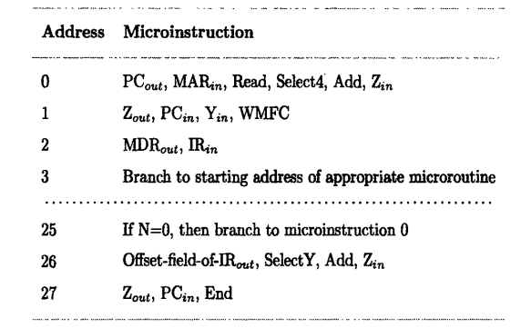
Whenever a new instruction is loaded into the IR, the output of the block “starting address generator” is loaded into the µPC.
The µPC is then automatically incremented by the clock, causing successive microinstructions to be read from the control store. Hence the control signals are delivered to various parts of the processor in the correct sequence.
Whenever a branch instruction is encountered, a branch microinstruction transfers the control to the corresponding microroutine, which is assumed to start at a location (example: 25) in the control store.
That address is the output of the starting address generator block.

Slide 102
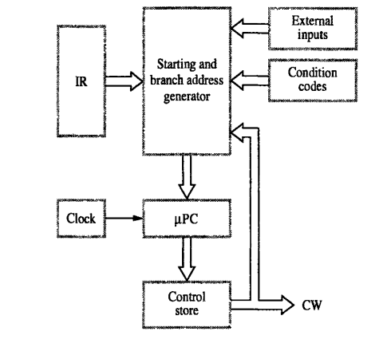
The microinstruction at location 25 test the N bit of the condition codes. If this bit is equals to 0, a branch takes place to location 0 to fetch a new machine instruction.
Otherwise, the machine instruction at location 26 is executed to put the branch target address in register Z.
To support microprogram branching, the organization of the control unit should be modified as shown in the figure.

Slide 103
In this control unit, the µPC is incremented every time a new microinstruction is fetched from the microprogram memory, except in the following situations:
When a new instruction is loaded into the IR, the µPC is loaded with the starting address of the microroutine for that instruction.
When branch instruction is encountered and the branch conditions is satisfied, the µPC is loaded with the branch address.
When an End microinstruction is encountered, the µPC is loaded with the address of the first CW in the microrountine for the instruction fetch cycle (address 0 in the example)

